Slide 1
REPORTING PROCESSES THAT INFLUENCE CULTURE CHANGE IN TERTIARY EDUCATION
Jan Hausman
Academic Manager
Bay of Plenty Polytechnic
Tauranga, New Zealand
August 2011
Notes:
Good afternoon
It is a while since my abstract was accepted and the reporting processes that we’ve changed have really moved us along the continuum?
If I stuck rigidly to the abstract it would mean just giving you historical data.
So, with this in mind, my paper that will be in the conference proceedings will talk about the historical picture, the evaluative process introduced and the layered approach to evaluating institutional health. It will also talk about a simultaneous organisational review of academic structures and processes in 2010.
This presentation however, will try to show you the here and now
– where we are on the improvement continuum
and where we plan to be tomorrow. To this end, I’ve embedded some of my colleagues into the presentation.

Slide 2
Presentation flow
From compliance focus report
To evaluative focus at team level
Why it changed
How it has worked at school level
To the institution overall
What next
Notes:
Presentation flow
The intention is to work through
What we’ve done in the past - with a compliance focused reporting process
How it changed - to an evaluative focus at team level
- encouraged by the New Zealand Qualification Authority
Why it changed
How it has worked - and made a difference at school level
AND
As an outcome of organisational restructure – how a different way of doing things will end with a different result
How it is still changing And then - What next

Slide 3
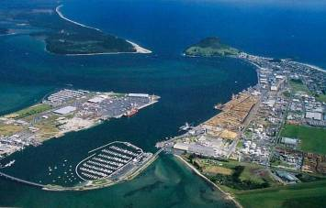
Tauranga
& Mt Maunganui
North Island
Notes:
To set the organisational context, Bay of Plenty Polytechnic is a medium sized regional polytechnic (about 3265 equivalent full time students) and we are located on the East Coast of the North Island of New Zealand.

Slide 4
Notes:
We have two main campuses and are structured as four Schools.
Each has a Head of School and then about 4 Groups in each School, each with a Group Leader.
These Groups have a set of like programmes of study contained within them.
We deliver certificate and diploma programmes at levels 1 through to 6.
We have a strong partnership with a university (Waikato) and
a Wananga (Awanuiorangi) .
And we arrange for the articulation from our two year diplomas into the third year of a degree, taught in Tauranga, through this partnership.

Slide 5
Quality assurance in NZ
Inputs based audit
To
Outcomes focused self evaluation and external evaluation and review

Slide 6
NZQA – The Key Evaluation Questions
How well do programmes and activities match the needs of learners and stakeholders?
How well are learners guided and supported?
How effective is the teaching?
How well do learners achieve?
What is the value of the outcomes for key stakeholders including learners?
How effective are governance and management in supporting educational achievement?
Notes:
In NZ, quality assurance and accountability in education had been demonstrated through an internal and external audit approach – that is it was based on mainly looking at inputs based systems. The audit approach had been operating for about19 years.
In the last couple of years, a different system – one of self evaluation and external evaluation and review was introduced by the NZ Qualifications Authority .
This came through a trial mode that we participated in during 2009, and then in reality in 2010 when we experienced the first External Evaluation and Review for the polytechnic sector.
CLICK HERE
A key tool that we use for self evaluation is an annual programme review report. This focuses on answering the NZQA key evaluation questions relating to:
The needs of learners and stakeholders
Learner guidance and support
Teaching effectiveness
and learner achievement
The value of the outcomes
And the effectiveness of governance and management processes in supporting learner outcomes.

Slide 7
APR - How effective is the teaching?
Teaching delivery
Discuss the effectiveness of the teaching on this programme and how you know it is effective?
How effective was your timetable/teaching delivery plan? What has worked really well as far as teaching practice is concerned this year? How have foundation learning strategies enhanced the teaching and learning on your programme (this might include diagnostic assessment, embedded literacy and numeracy)?
Discuss how delivery options have enhanced or impeded programme delivery to Maori students?
Discuss any teaching/learning strategies that have been implemented that recognise diversity in the classroom?
If you could propose new delivery modes or techniques to improve Maori student learning engagement, what would these be?
Notes:
The Template for this Report is structured with headings and then questions which act as discussion prompts
The example on this slide looks at KEQ 3 – “How effective is the teaching” – note the focus in the prompts is on “how” and “how do you know…”
And if you look at bullet 2 - you will note that this specifically looks at literacy and numeracy that has received significant attention in NZ since 2009.
We are particularly interested in the “health of the programme”.
The evaluation of this ‘health status’ is achieved through team discussion and consensus agreement.
We’ve had an APR process in varying forms for at least 10years and we noticed that we hadn’t moved sufficiently from reporting fact – “the what”.
We needed to push on and to ask the questions of “so what” and “now what”.

Slide 8
One important idea
If you always do what you’ve always done, you’ll always get what you always got (Anthony Robbins)
Notes:
Some time back Robbins in his leadership teaching noted that
“if you always do what you’ve always done, you’ll always get what you always got”
This means we need to change.
In 2010 we made two key changes
to the timing of receiving these reports ,
And, the second to the way different staff members were involved.

Slide 9
What changed?
Timing – discussion December and January – before next cohort started.
Different staff involved in a layered approach
Notes:
For the 2009 APR, team discussion occurred early December 2009 and late January 2010.
All APRs were completed for discussion at the School Board of Studies, by March 2010.
The timing is so important – to reflect on the year just gone before people become engrossed in the current, new year programme and students.

Slide 10
Cross Institutional evaluation of programme health by reflecting on the Four Head of School reports and the team annual programme review reports
Head of School Applied Science–
read all APRs and produced a Health of the School Report
Programme evaluation by the teaching teams – (approx 90)
Head of School Applied Technology– read all APRs and produced a Health of the School Report
Head of School Business Studies – read all APRs and produced a Health of the School Report
Head of School Design and Humanities – read all APRs and produced a Health of the School Report
Notes:
Two further layers of analysis were then applied.
The first layer involved the Head of School providing a “State of the School’s Health” report by reading all APRs, the retention and completion data and taking into account other available data such as programme and teaching evaluations and any complaints.
Each Head of School was able to identify trends in teaching and learning and any student issues across the School so that areas of school-wide improvement could be identified and worked on. This meant that rather than the APRs just reflecting what was happening in a programme of study, now there was a school-wide focus to share ideas across a range of programmes.
The next layer of analysis and reporting involved the Director Academic and Academic Manager reading all APRs plus the four Head of School reports. They then wrote an institution-wide report to note trends and matters that needed to be considered and addressed at an institutional level.
The report was discussed at Academic Board, and then an improvement focus was taken.
This then involved all four Heads of School, two Directors, and the Academic Manager meeting on four occasions to discuss the areas for improvement and to develop institutional strategies to achieve the changes.

Slide 11
Tim – Head of School
Notes:
This year, one Head of School decided to try something different.
The Head of the School of Applied Science chose to call an all school meeting for the presentation of the 2010 APRs. That is rather than use the smaller membership of the Board of Studies, he invited all administrative, tutorial and technician staff to participate in the APR presentations. He also called for his team to take a closer look at trends in their programmes of study over the last three years.
VIDEO CLIP 1 – I asked Tim why he decided to do this and how it has created improvement?

Slide 12
Even more change
Notes:
2010 was a big year of change.
We also decided that we needed to reduce some of the bureaucratic layers of decision making at the polytechnic. There appeared to be too many layers and these layers affected decisions related to
to the approval of results
and approval processes for changes that would bring improvement for student outcomes
We really wanted to create an environment of increased trust and to move decisions being made where possible at the teaching team and School level rather than centrally.

Slide 13
Group Programme Committees
Group Leader, All Academic Staff, Programme Administrator and
Academic Adviser
Notes:
We also wanted a closer focus on student engagement, retention and progress to ensure that student completion rates and progression to the next level of study could be as good as we could get them.
To achieve those goals, we carried out a trial in the School of Design and Humanities. This involved a less formal structure of meetings but involving more people.
Group Programme Committees were established and this put a cross section of teaching and support staff into an environment where they could talk about their students, about what was working well, and what needed more work.
This also meant that suggestions could be shared from other programme areas.
We removed Programme Assessment Committees that had functioned purely to carry out a checking of results and responsibility for accuracy of the results put where it belongs, that is with the Tutors, Programme Coordinators and Group Leaders.

Slide 14
Mary – Group Leader
Notes:
The concept was challenging at first, but after 9 months of trial, here is what Mary – the Group Leader for Culture and Education has to say:
VIDEO CLIP 2- Mary – in the trial of getting Group Programme Committees together, you found some differences in the way you worked – can you tell us about that (Retrospective to Proactive)

Slide 15
A School Leadership Team replaced the Board of Studies
Head of School, Group Leaders,
Academic Adviser and
Administration Team Leader
Notes:
Mary mentioned that reports from the Group Programme Committees were then taken to the second new group – this is the School Leadership Team.
This group comprises the Head of School, all Group Leaders, the School Academic Adviser and the Administration Team Leader. This group was given the authority to make both academic and school management decisions and to just refer relevant matters to higher level decision makers.
This School Leadership Team replaced the School Board of Studies which had been a large very paper based committee.

Slide 16
Notes:
With the regular feed in through the Group Programme Committees, the Head of School was well informed about student progress, about teaching, learning and assessment and also about staff matters. This meant that she was even more informed when she needed to produce the Health of The School report in March of this year.
VIDEO CLIP 3 – I asked Gill – how the trial has made a difference?

Slide 17
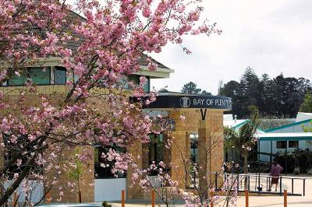
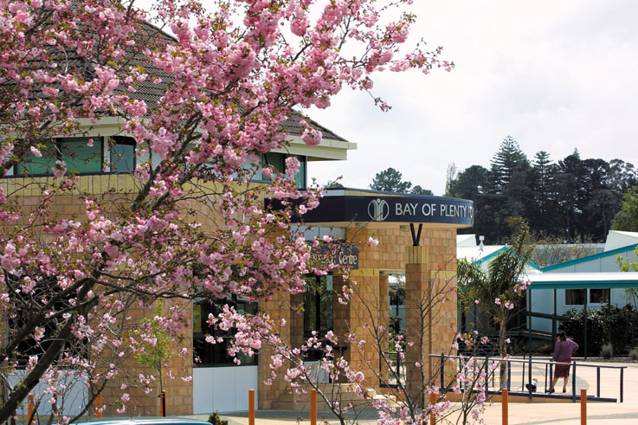
Where to now?
Notes:
As mentioned at the outset of this presentation, we are on a continuum of improvement and this can only occur with culture change. The trial of Group Programme Committees has shown that this is a very worthwhile change with great potential for sharing of ideas, resources and improvement. We’re now rolling out this change in the other three schools.
I will also argue that the change in the way that Annual Programme Review reporting is done, that is the layered approach, is having a positive impact on culture change at Bay of Plenty Polytechnic. In that it is deepening the analysis.
Our place on the continuum is affected by the evolving understanding of, and confidence in, self evaluation. It is also affected by the increasing levels of trust applied through the more organic academic and administrative decision making structure. And finally, the culture is affected by a multi layered but increasingly integrated application of improvement processes.

Slide 18
What next?
Strategic directions and planning process
REACH performance development process
Business unit self evaluation
Programme health - multilayered
Notes:
As a heads up on improvement for the future, we are now looking at a greater synergy between
the BoPP Strategic Directions and Planning process,
the performance development process,
business unit self evaluation,
and programme health.
It is an exciting place to be – watch this space.

Slide 19
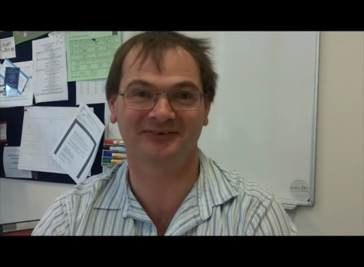
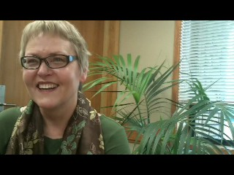
Thanks to colleagues
Tim
Mary
and Gill
for their contribution
Notes:
And finally, I’d like to thank my colleagues for sharing their ideas and images.

Slide 20
Thanks for listening and any questions please
Notes:
Thank you.

